Slide 1
Vectors
Eigenvectors and Eigenvalues

Slide 2
Outline
Eigenvectors and Eigenvalues
The Covariance Matrix
Eigen Decomposition of the Covariance Matrix

Slide 3
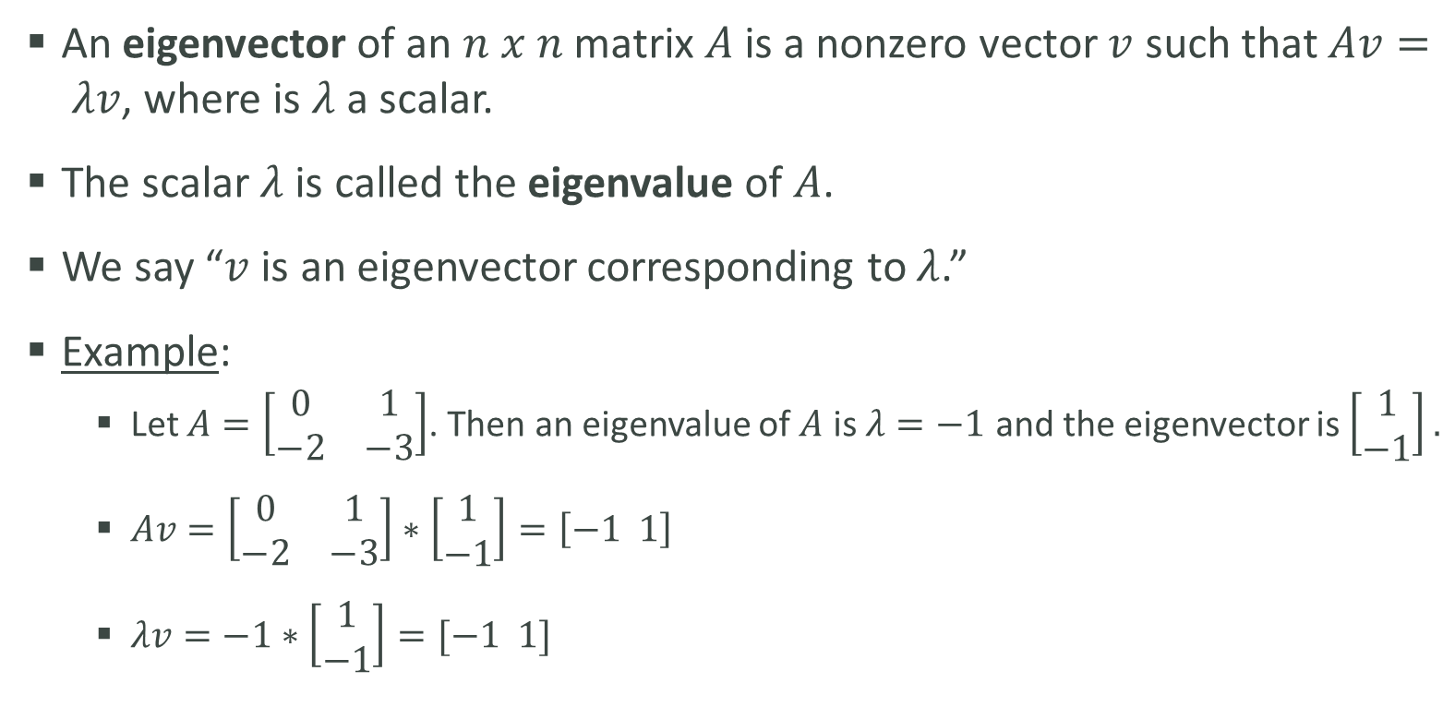
Eigenvectors and Eigenvalues
An eigenvector of an $n x n$ matrix $A$ is a nonzero vector $v$ such that $Av= λv$, where is $λ$ a scalar.
The scalar $λ$ is called the eigenvalue of $A$.
We say “$v$ is an eigenvector corresponding to $λ$.”
Example:
Let $A=\left[\begin{matrix}0 & 1 \\ −2 & −3\end{matrix}\right]$. Then an eigenvalue of $A$ is $λ=−1$ and the eigenvector is $\left[\begin{matrix}1 \\ −1\end{matrix}\right].$
$Av=\left[\begin{matrix}0 & 1 \\ −2 & −3\end{matrix}\right]∗\left[\begin{matrix}1 \\ −1\end{matrix}\right]=\left[−1 1\right]$
$λv=−1∗\left[\begin{matrix}1 \\ −1\end{matrix}\right]=[−1 1]$

Slide 4
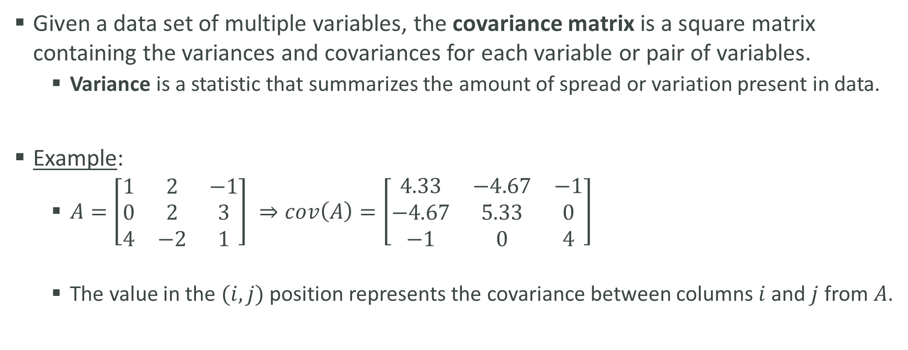
The Variance/Covariance Matrix
Given a data set of multiple variables, the covariance matrix is a square matrix containing the variances and covariances for each variable or pair of variables.
Variance is a statistic that summarizes the amount of spread or variation present in data.
Example:
$A=\left[\begin{matrix}1 & 2 & −1 \\ 0 & 2 & 3 \\ 4 & −2 & 1\end{matrix}\right] ⇒cov\left(A\right)=\left[\begin{matrix}4.33 & −4.67 & −1 \\ −4.67 & 5.33 & 0 \\ −1 & 0 & 4\end{matrix}\right]$
The value in the $(i, j)$ position represents the covariance between columns $i$ and $j$ from $A$.

Slide 5
Eigen Decomposition of the Covariance Matrix
Eigenvectors and eigenvalues of the covariance matrix are used to determine where the most amount of variation in the data occurs.
If the covariance matrix has an eigenvalue of 0, it could mean there is a linear dependency in the data set
The converse is not true! If the covariance matrix does not have an eigenvalue of 0, it does not mean there isn’t a linear dependency in the data set
Technically, an eigenvalue of zero means there is no more variation in the data. This is often caused by a linear dependence.
This concept is used in most common dimension reduction techniques.

